Slide 1
PickX First Break Picker
Matt Duiker
XtremeGeo LLC

Slide 2
Preliminary comment
All Flatirons customers on an active lease or on maintenance are entitled to the use of Flatirons++
Flatirons++ includes Flatirons, Phoenix, and PickX

Slide 3
Topics
Examples
Technology
Training
Integration
Case study
Success rate and known issues

Slide 4
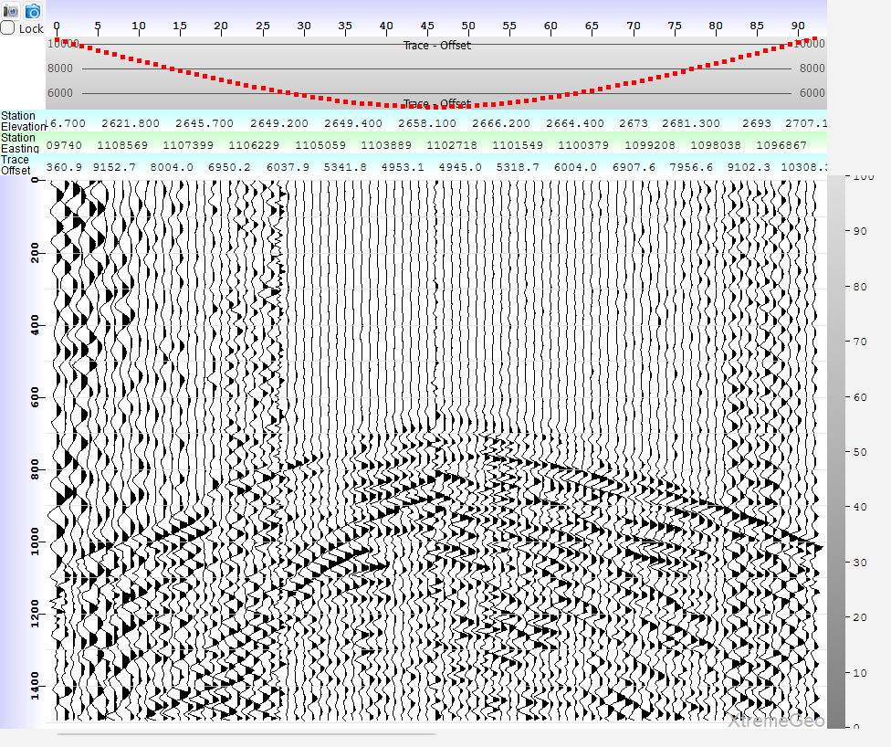
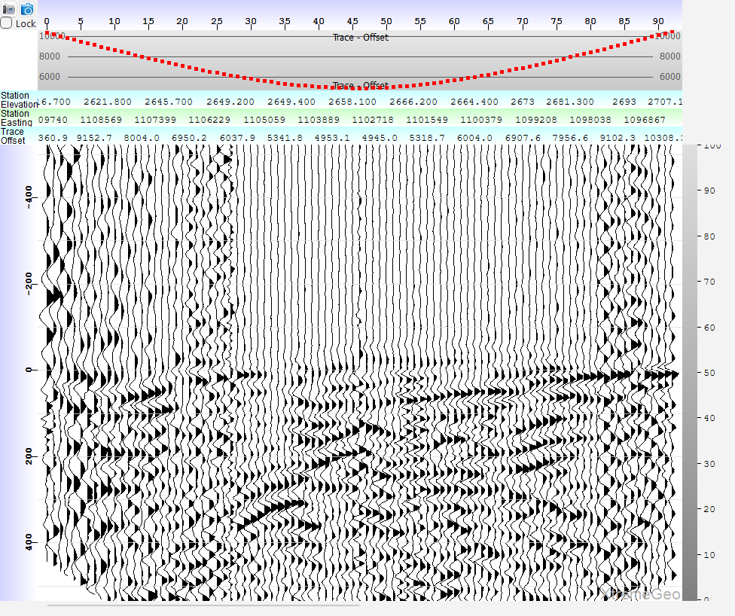
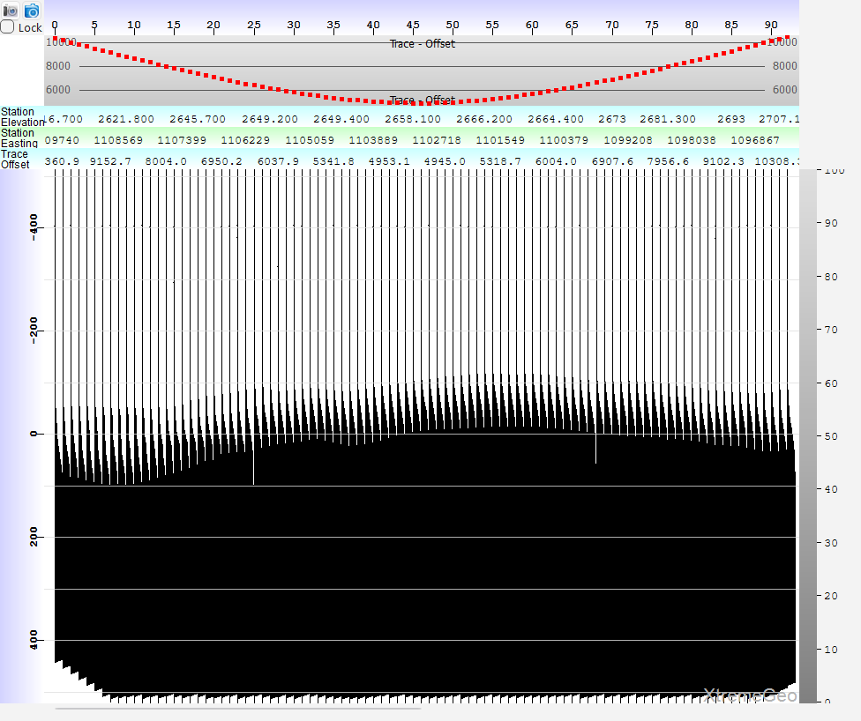
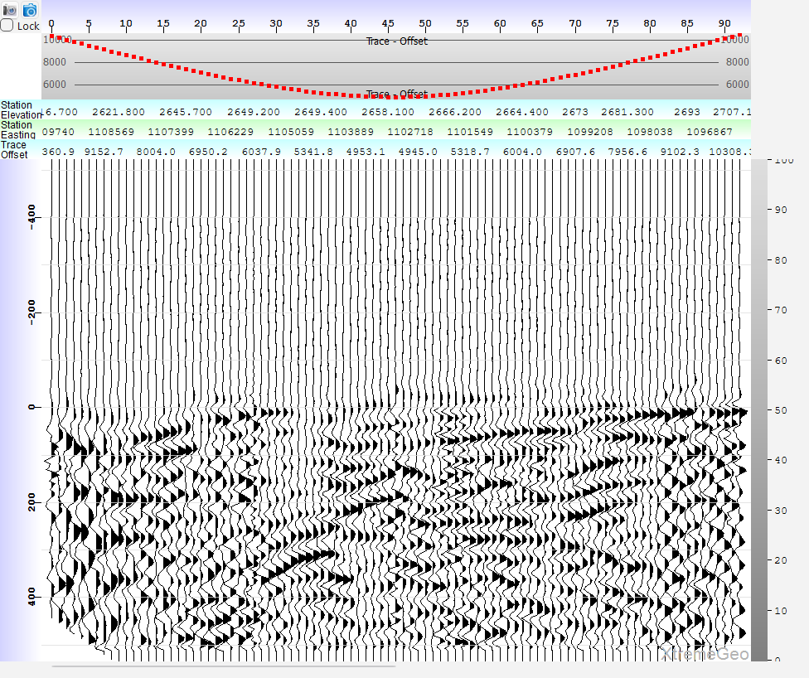
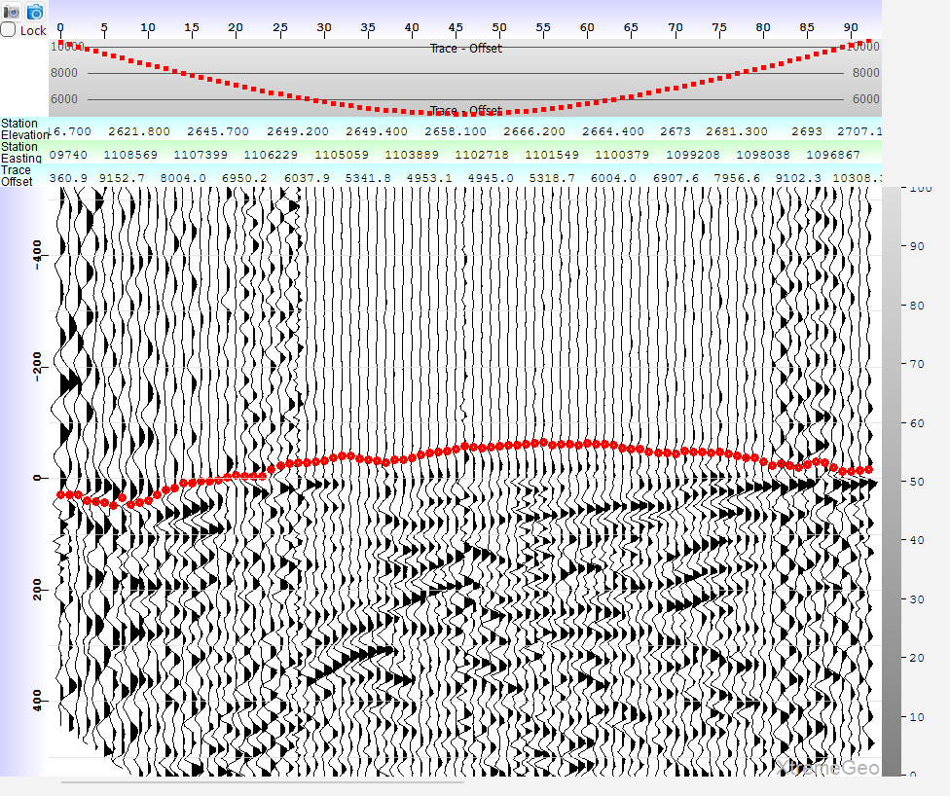
First let’s answer the question, How does PickX create picks?
Step 1 – input gather
Step 2 – Apply moveout
Step 3 – U-Net segmentation
Step 4 – segmentation applied
Step 5 – final “onset” picks

Slide 5
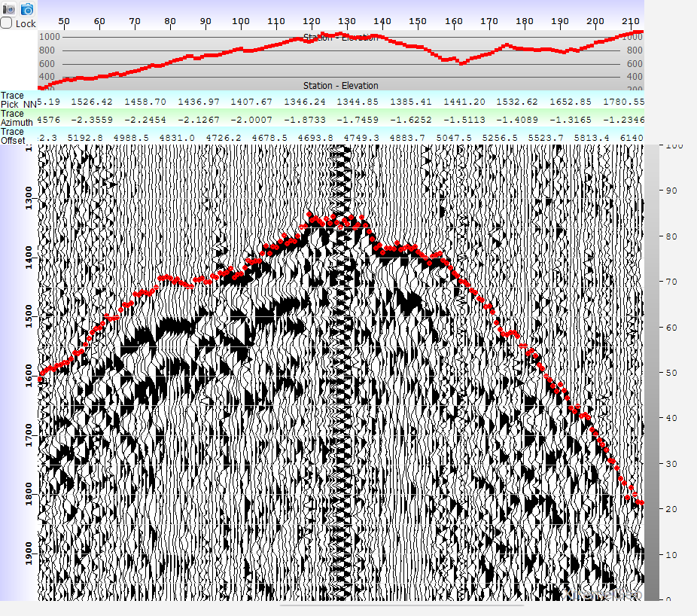
Example, South America PickX model trained on Permian Basin Data!!!
800m elevation variation
Picks through low signal/noise regions

Slide 6
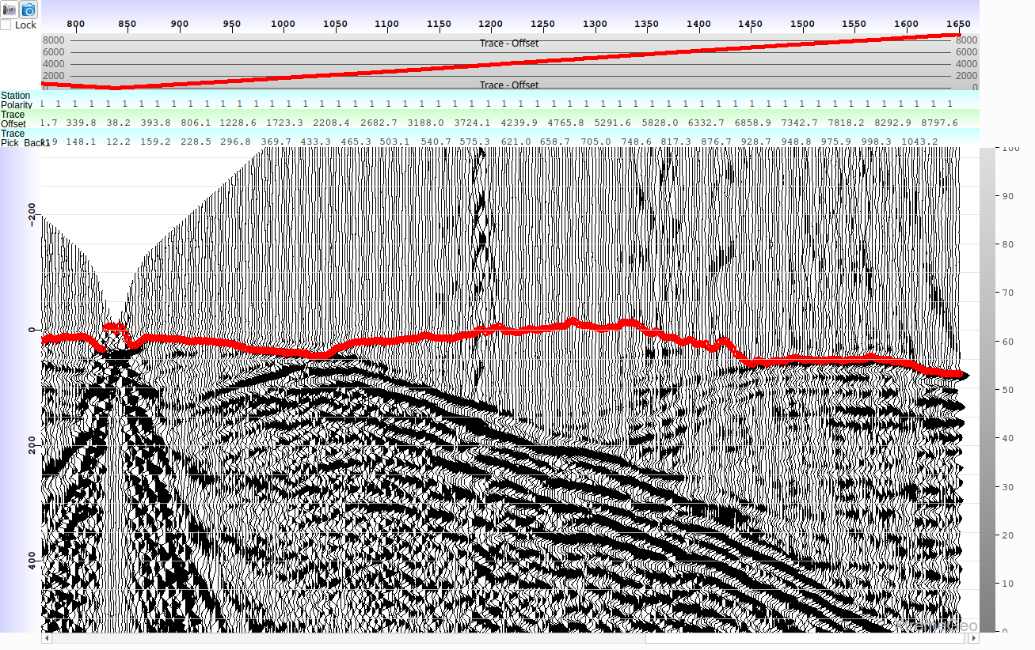
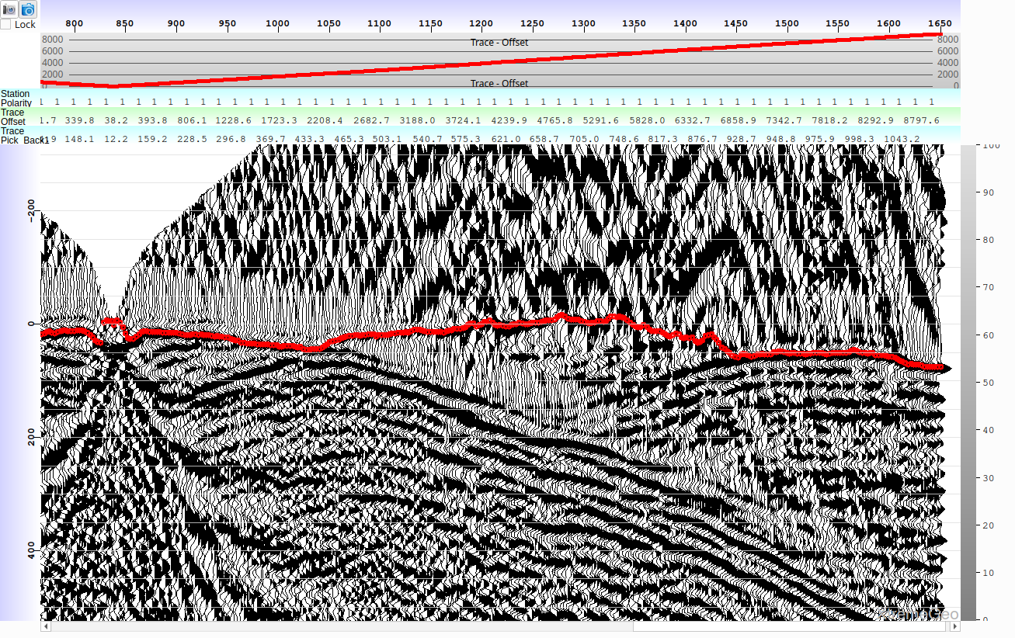
Example
Same gather with AGC applied

Slide 7
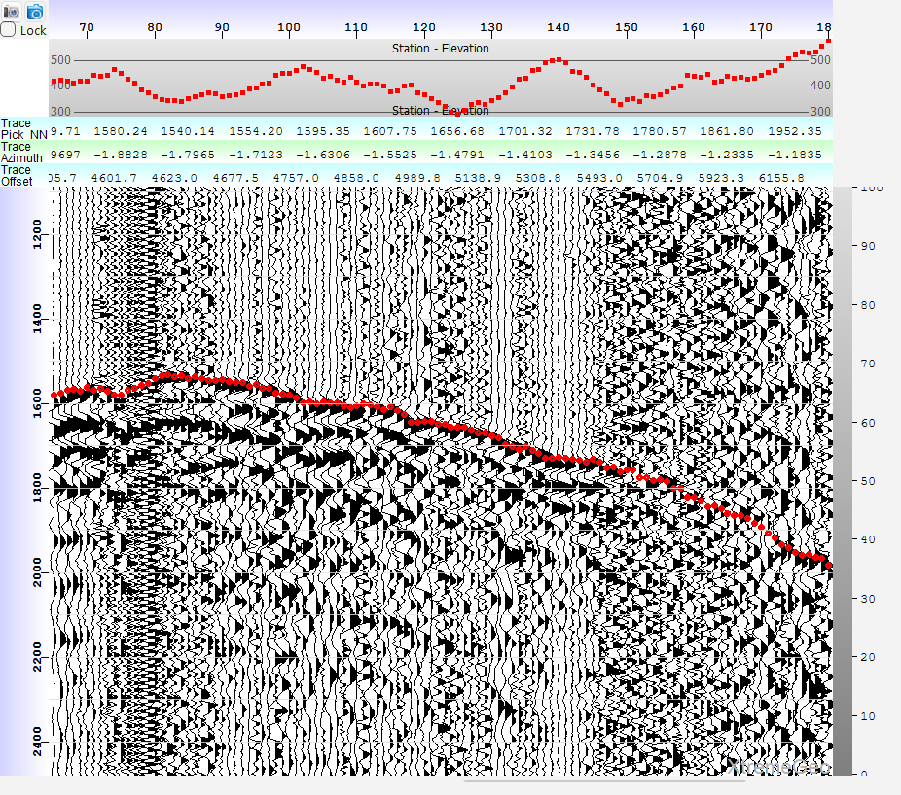
Example, South America

Slide 8
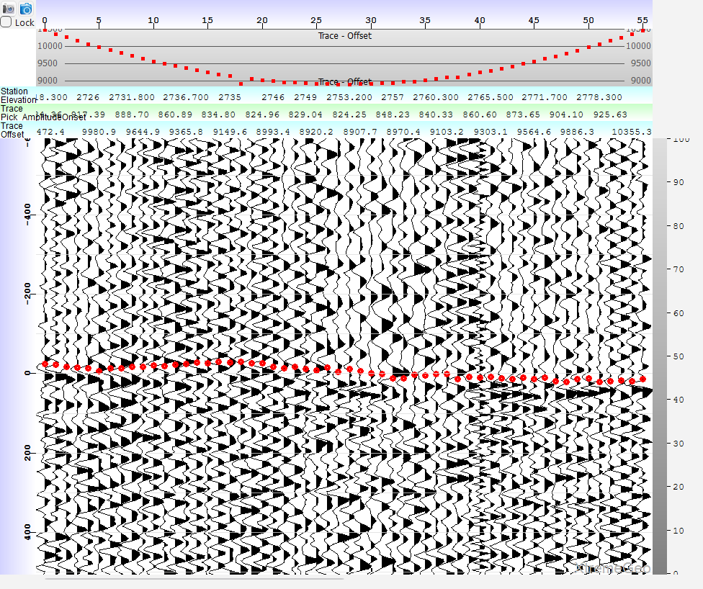
Example, Delaware basin

Slide 9
Technology
No Python!!! (We finally abandoned a Python AI project after years of work)
C++ code is simpler, cleaner, faster to develop (a somewhat controversial opinion)
The use of C++ enables easy integration with other XtremeGeo code
Should simplify connection to third-party data
PickX built using LibTorch, which is the basis of PyTorch
Our earlier attempt at AI first break picking, DeepTrace (discontinued), used Python and TensorFlow.

Slide 10
Technology, cont.
PickX treats first break picking as an “image segmentation” problem – it divides the seismic gather into two regions, before and after the first arrival
It does NOT try to directly predict picks! This was the approach taken by the earlier attempt, DeepTrace
Thousands of articles about image segmentation, especially for medical imaging
Dozens of designs to choose from
Several different architectures were tested, including the basic U-Net design and several atrous approaches.
Experimentation showed that training data preparation is perhaps more important that the architecture, and so the basic U-Net design was selected for the first release of PickX

Slide 11
Training
Training new models is a relatively fast process, just a few hours on a GPU
The current release of PickX uses either Flatirons projects or Phoenix projects
Future releases will use third-party data “in-place” without the need to export SEGY data
The training data should have a moveout trends defined and a decent set of first break picks
The moveout trend does not need to be perfect – indeed a bit of “wobble” can help stabilize the training model.
The picks should be as good as possible.

Slide 12
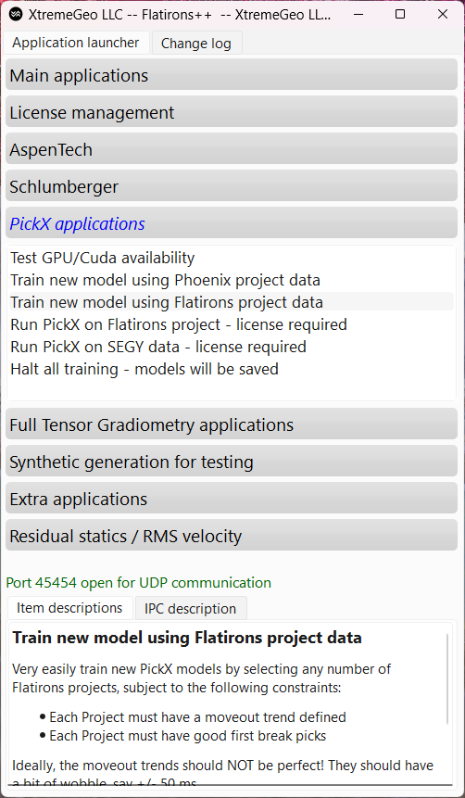
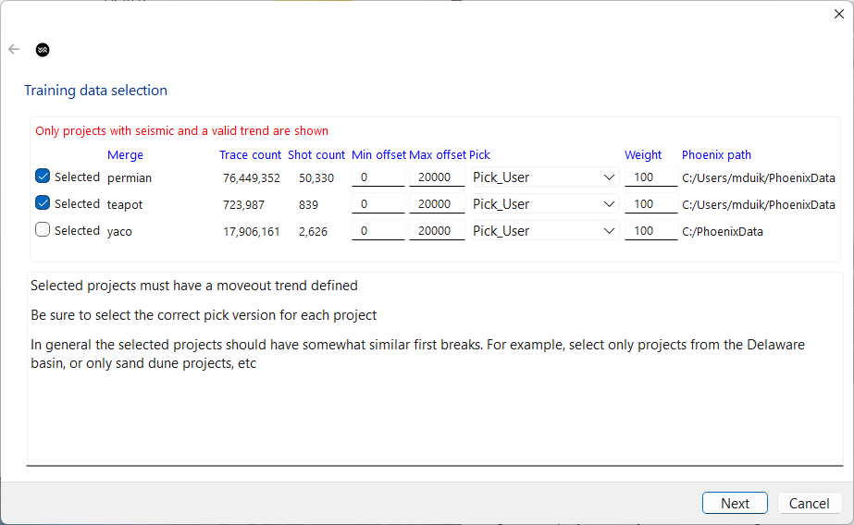
Training a new model Just the workflow, no details…
Next, select any number or projects.
Usually, the projects will be from the same region
Launch Flatirons++ and
select one of the “Train”
options..

Slide 13
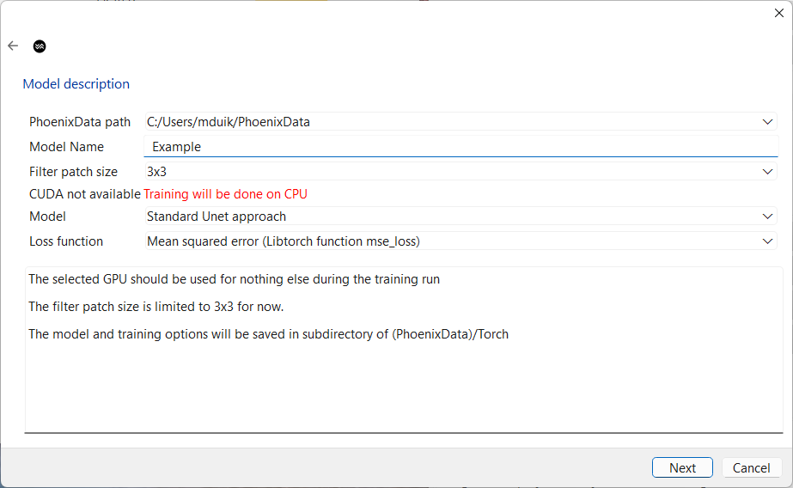
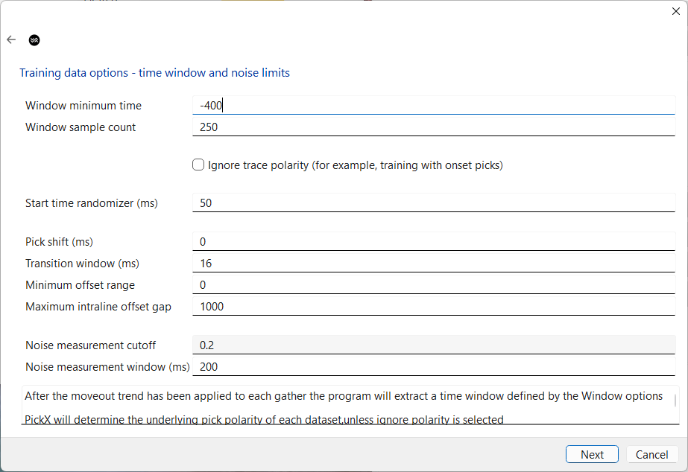
Training a new model (not a tutorial)
Give the model a name
Segmentation options, start time wobble

Slide 14
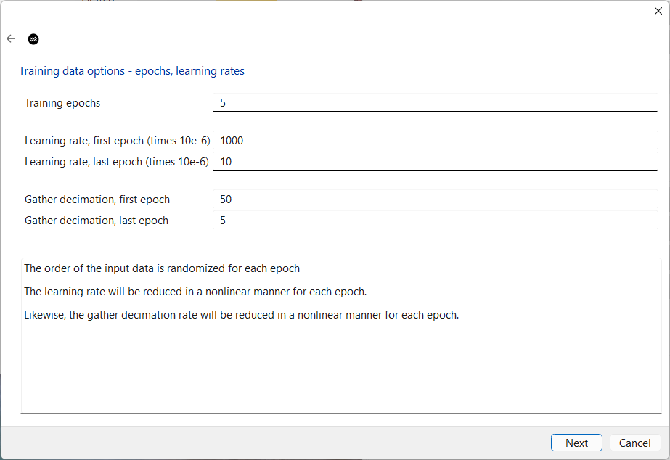
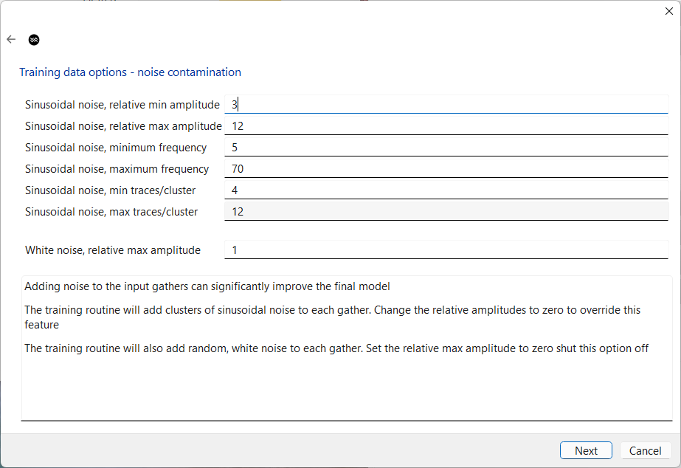
Training a new model (not a tutorial)
Training rates, epochs, decimation
Noise contamination

Slide 15
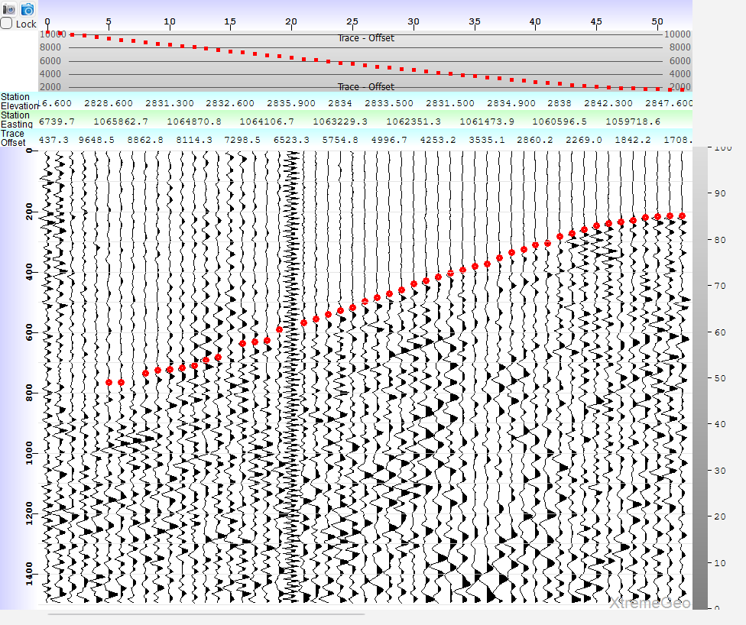
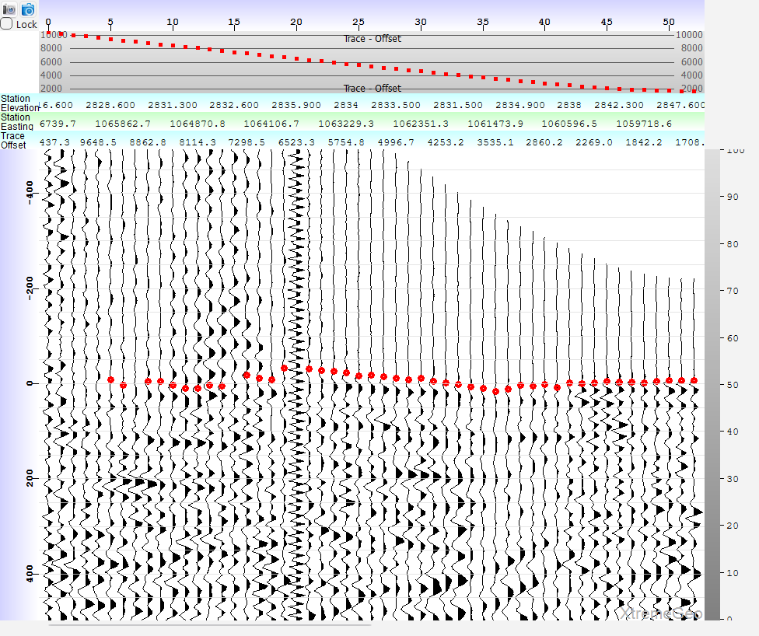
Training process for a single gather
Input gather
Moveout + wobble
Input gather with user picks.
Data from a notoriously difficult survey.
Client said it took about 3 months to pick
using a combination of auto and hand picking
Apply moveout trend.
After applying moveout the training algorithm
will add some random “wobble” to the start times

Slide 16
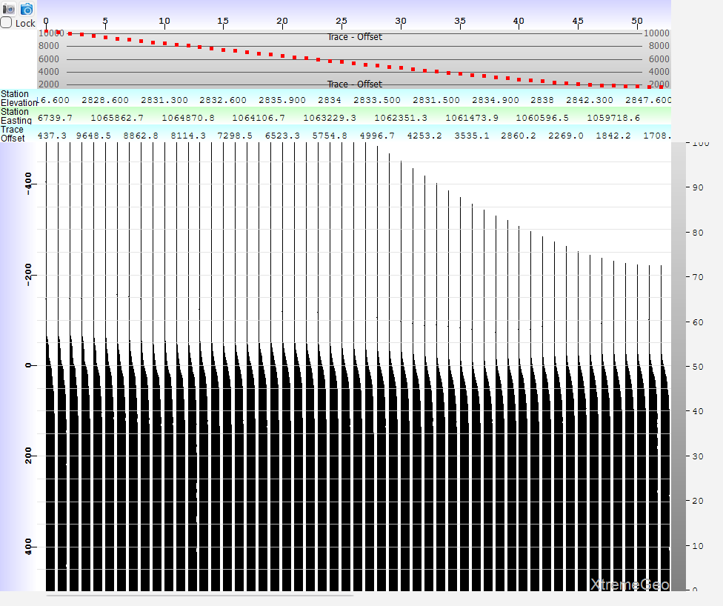
Training process – compute desired segmentation
Moveout + wobble
Computed segmentation
The input gather is “segmented” using
the first break picks. Note the smooth
transition of about 20 milliseconds
This is the desired output of the U-NET!

Slide 17
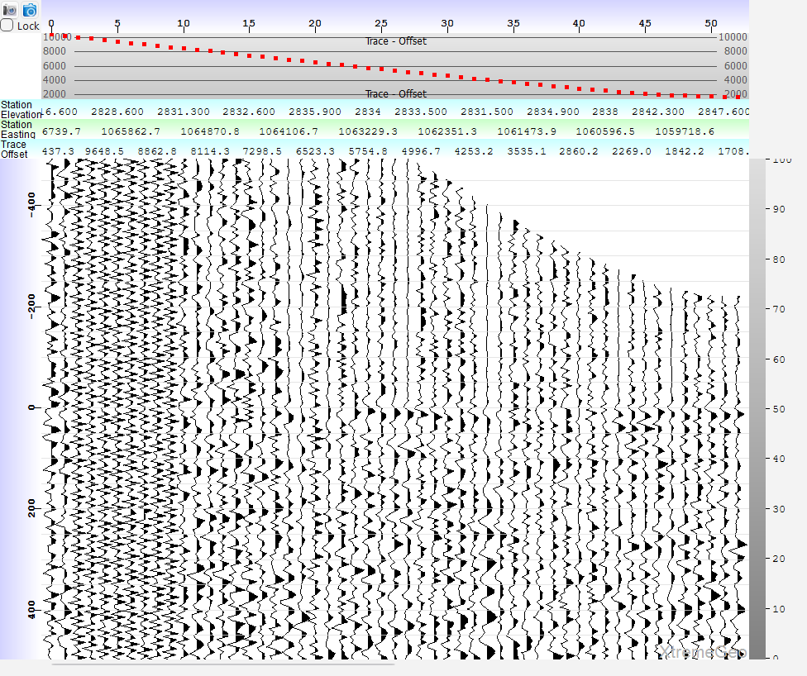
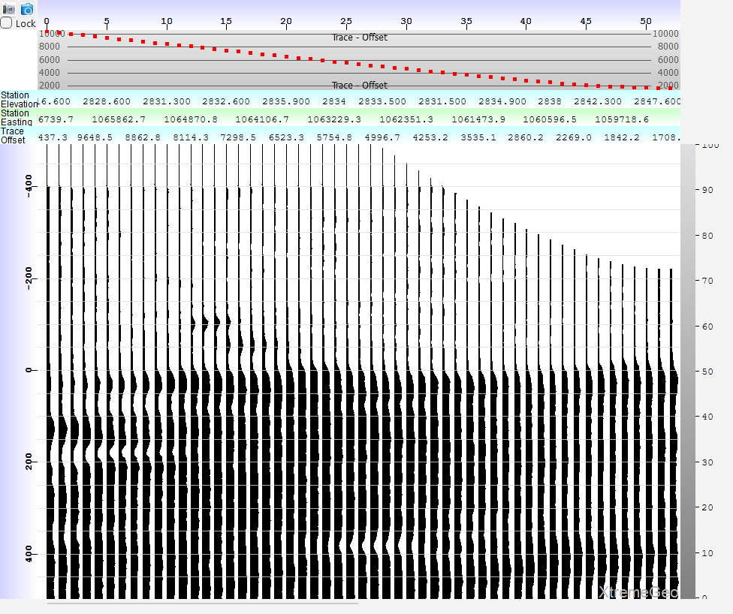
Training process – compute predicted segmentation
Moveout + wobble
Add noise to input gather
Predicted segmentation
Add random and coherent noise to
the input before feeding it to the U-Net
Options are user controlled
This was generated by feeding the
noise-modified input gather
into the U-Net.

Slide 18
Training process, back propagation
Compute the error for this gather by subtracting the predicted segmentation from the computed segmentation
This error term is fed back into the LibTorch machinery
Skipping lots of details (batch size, learning rates, etc.)

Slide 19
Integration
PickX can be used with
Phoenix projects. It is fully integrated into the various picker windows
Flatirons projects. A stand-alone executable can be launched from Flatirons++
SEGY files. Any number of SEGY files may be picked simultaneously
Other third-party options soon – Echos getting close to complete

Slide 20
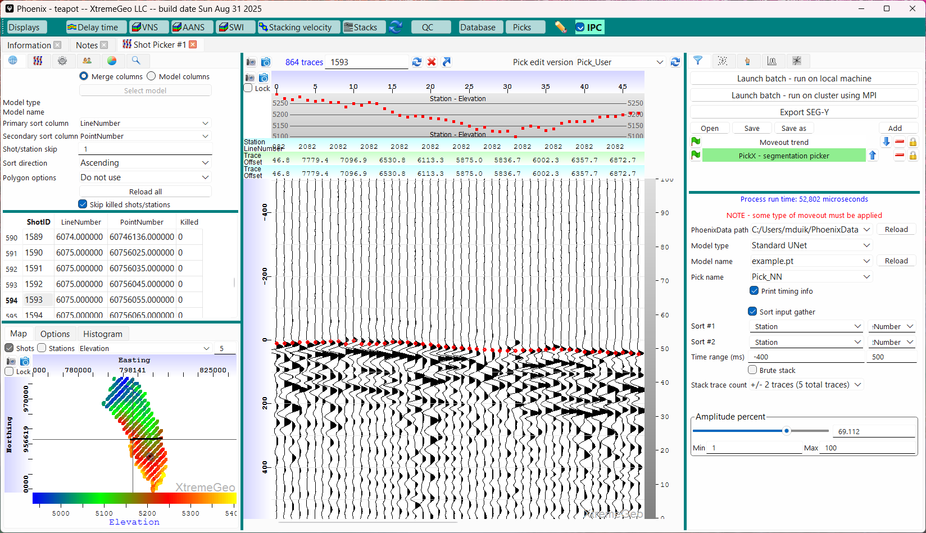
Integration with Phoenix

Slide 21
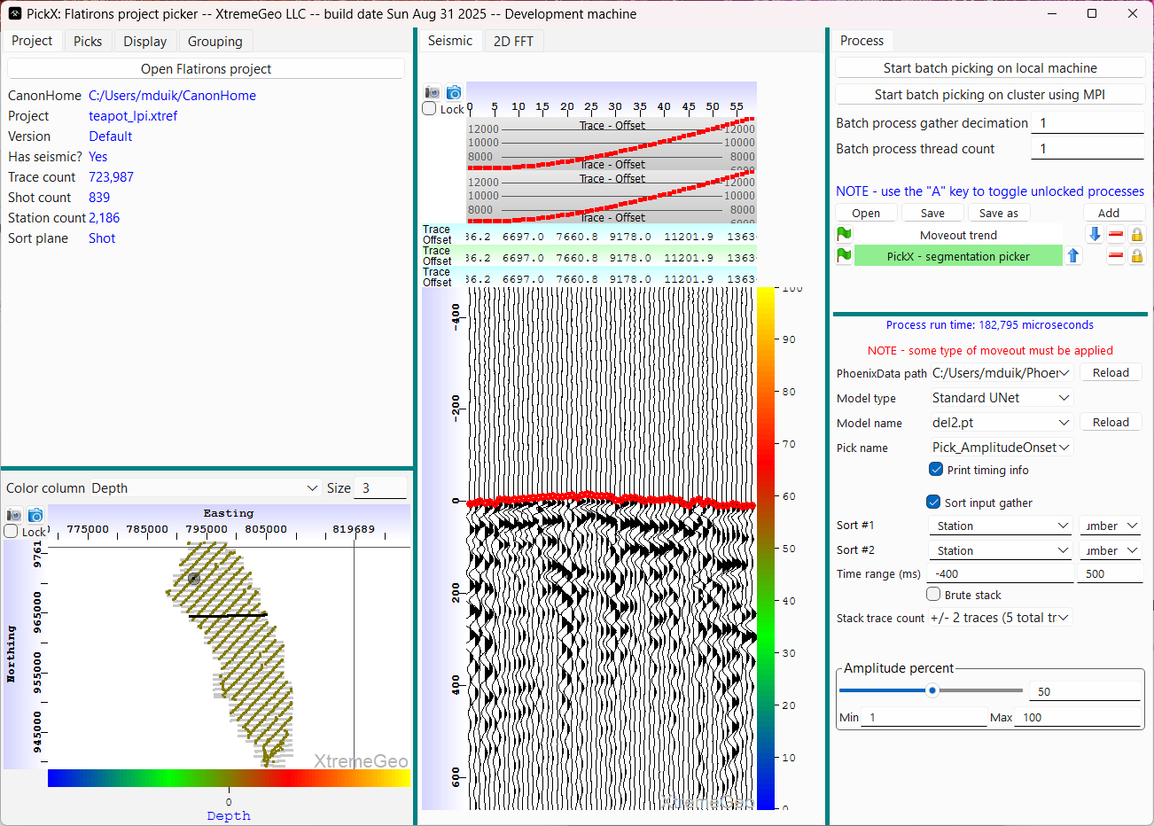
Integration with Flatirons This application is launched from Flatirons++

Slide 22
Case Study
Delaware Basin, West Texas
60 million traces
50 sq miles
Several vendors have processed this dataset
They report about 2 months to get decent picks
They used a combination of threshold auto picks, manual picks, and delay time stacking picks
PickX took 4 hours to pick on a fast desktop running on the CPU

Slide 23
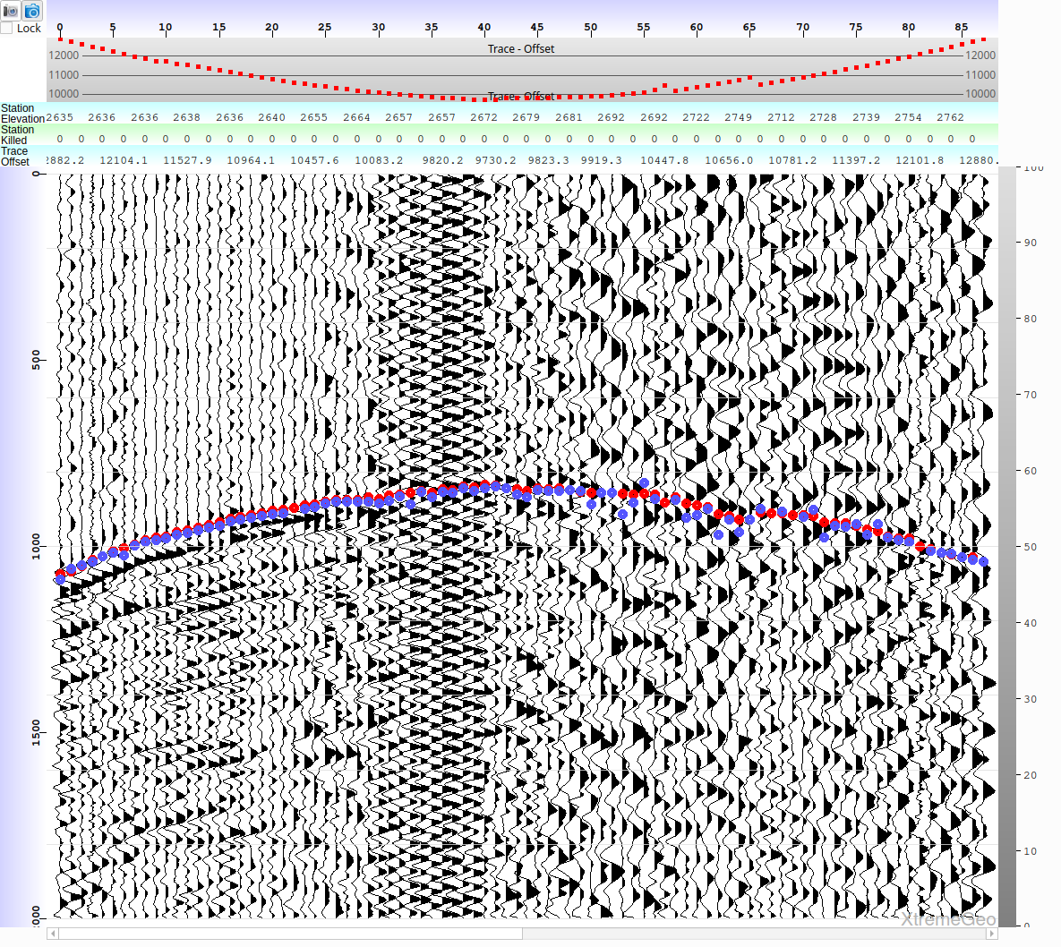
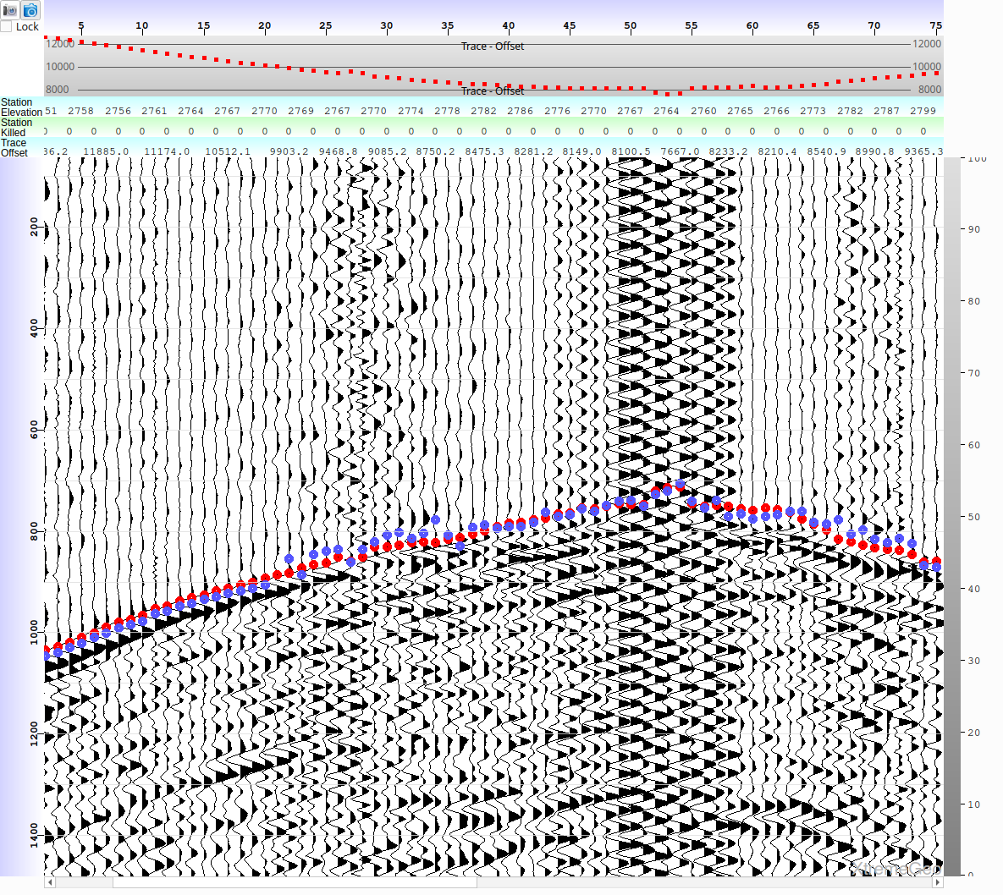
Case Study, PickX results User picks are blue, PickX are red

Slide 24
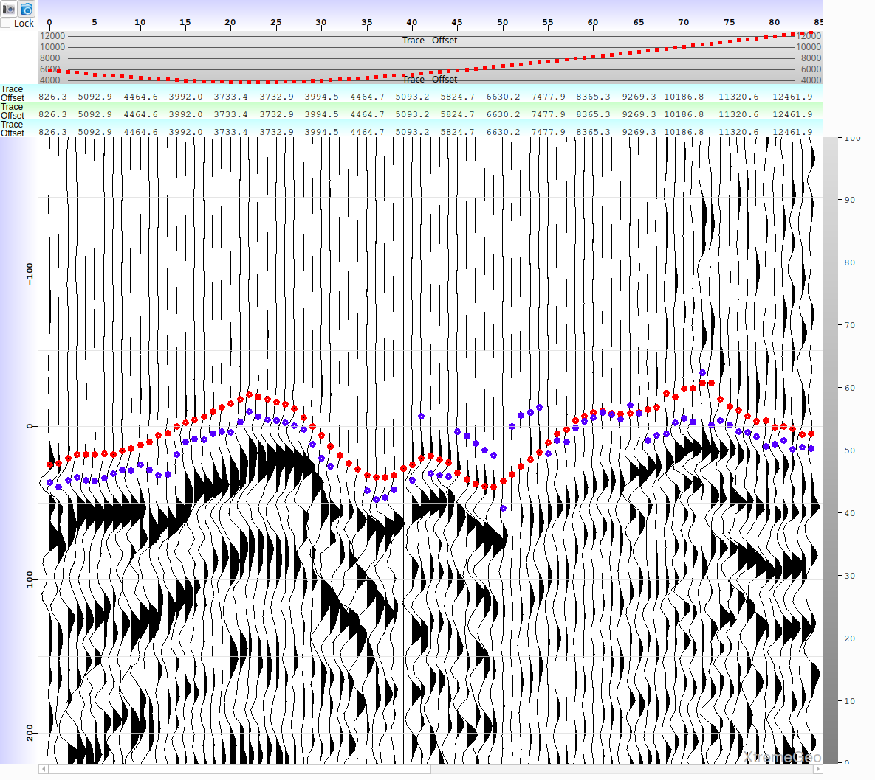
Case Study, PickX results User picks are blue, PickX are red

Slide 25
Case Study, results
How to compare pick quality? Do the picks really make a difference?
The simplest way to compare is to perform a VNS tomographic inversion using both sets of picks and then compare pick error
Compare vertical travel times through the two models and look at a difference plot.
Interestingly, significant long wavelength variation, +/-5 ms across the survey
Smaller short wavelength variation
The client preferred the model generated with PickX picks

Slide 26
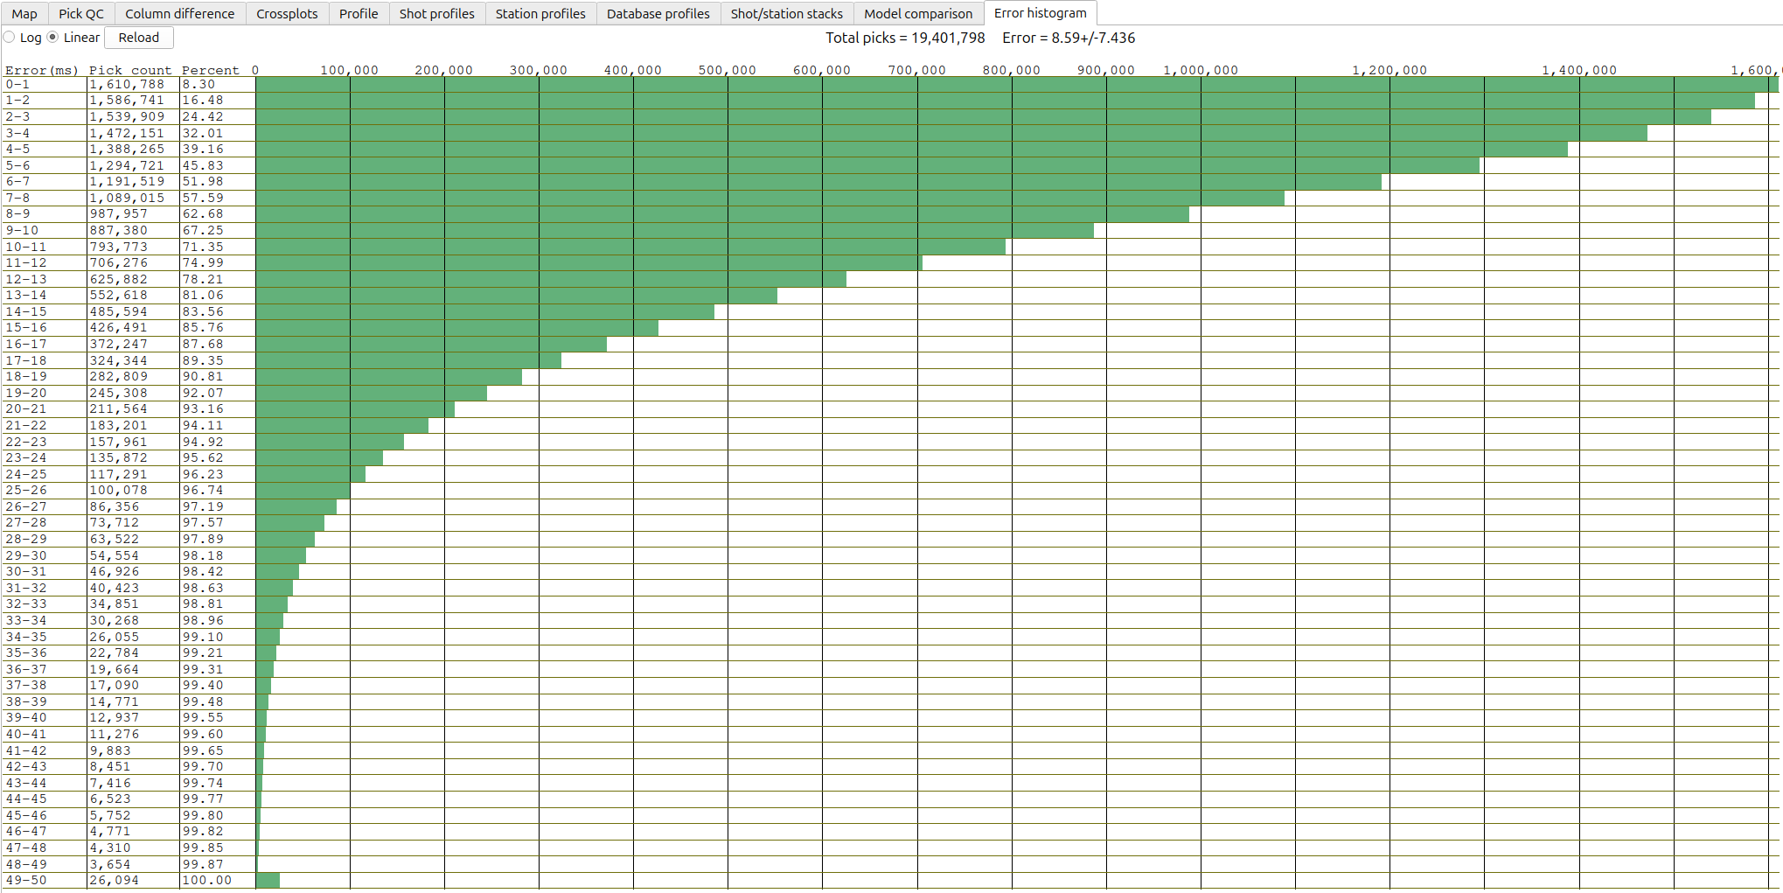
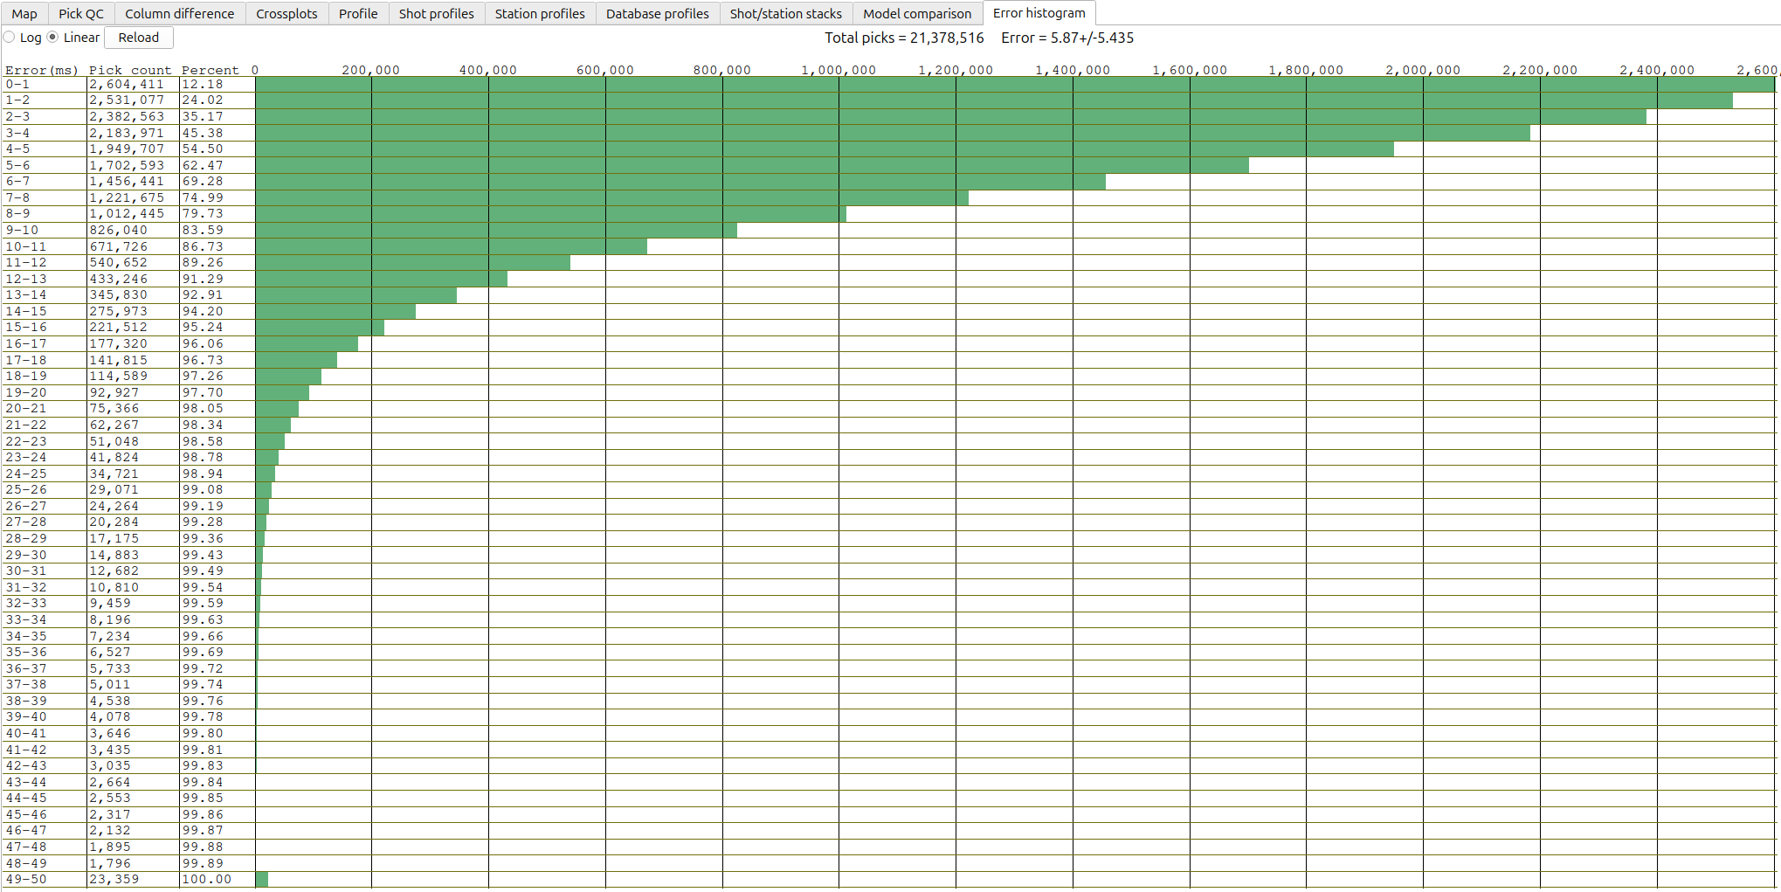
Case Study, pick error histograms Generated by the VNS tomographic inversion
User picks, error = 8.6 ms
PickX picks, error = 5.9 ms

Slide 27
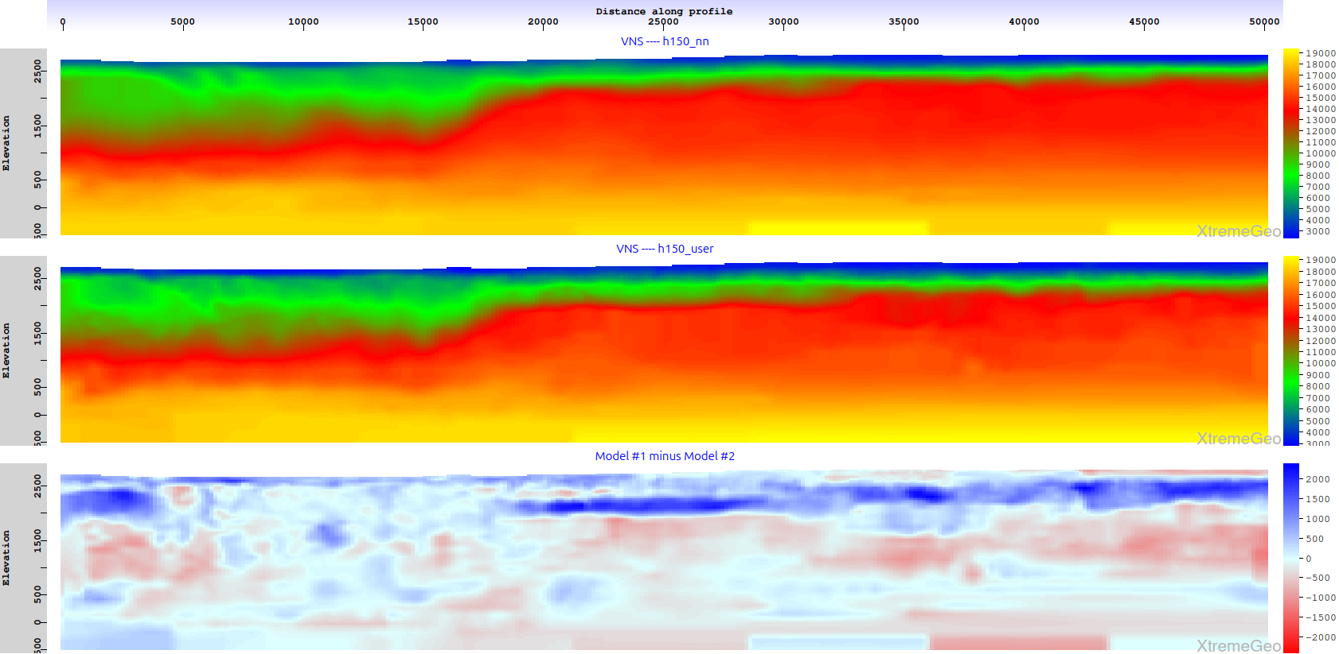
Case study, profile comparison
10 miles
PickX
User

Slide 28
Success rate and known issues
PickX has been successful on about 90% of the surveys that we are aware of
The handful of failures were usually solved by training a new model on more appropriate data
A couple of failures occurred due to wildly inaccurate moveout trend curves
Shingling is an unresolved problem (next slides)

Slide 29
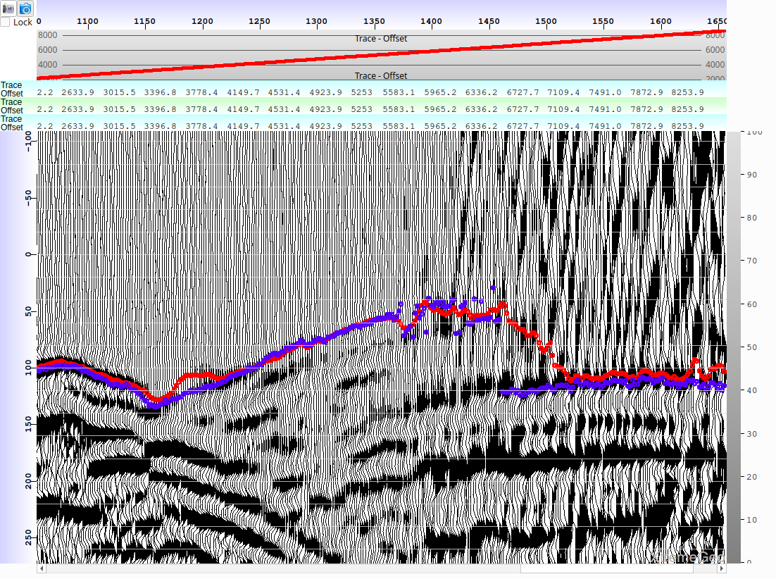
Shingling User picks are blue, PickX are red
This is a typical example of how
PickX handles shingling
It isn’t clear what else it should do?

Slide 30
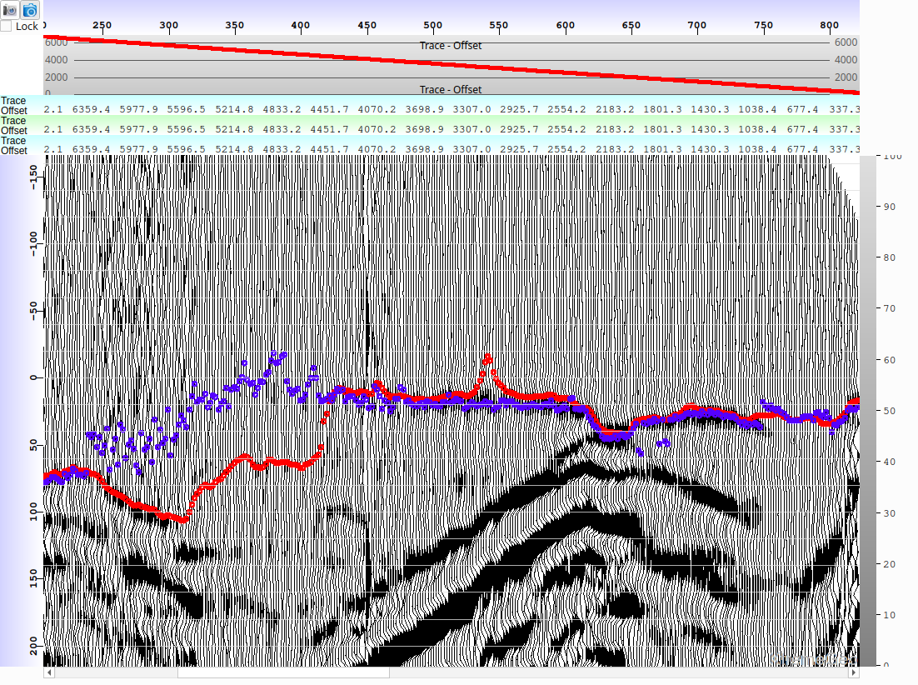
Shingling User picks are blue, PickX are red
Undertrained model
artifact

Slide 31
Future work
Investigate additional designs beyond U-Net, such as HRNet and DeepLab
Investigate training data preparation methods to help with shingling (??)
PickX runs on a cluster now, but only in CPU mode. Enable running on GPUs on a cluster

